Slide 1
Feature Selection

Slide 2
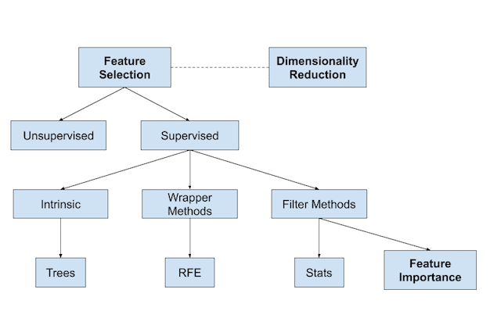
Overview of Feature Selection Technique

Slide 3
Feature Selection
Feature selection is a way of selecting the subset of most relevant features from original set of features by removing irrelevant, noisy, or redundant features
Select Best set of features

Slide 4
Benefits of Feature Selection
It helps in avoiding curse of dimensionality
It helps to reduce overfitting
It reduces training and testing time
It helps to improve accuracy

Slide 5
Feature Selection Technique
Filter Method
Wrapper Method
Embedded Method

Slide 6
Filter Method (Before Model Training)
The idea behind filter methods is to rank the features based on their relevance to the target variable or their correlation with other features. The ranking is done before model training, and the most relevant features are selected for the model.
The advantage of using filter methods before model training is that they are computationally efficient and can handle large datasets with many input features. By selecting only the most relevant features, filter methods can also reduce the risk of overfitting and improve the generalization performance of the model.
After applying filter methods, the selected features are used to train the model. Once the model is trained, it can be used to make predictions on new data. If the performance of the model is not satisfactory, other feature selection techniques, such as wrapper or embedded methods, can be applied to refine the feature selection and improve the model's performance.
In summary, filter methods are used before model training to select the most relevant features for the model, while wrapper and embedded methods are used during or after model training to refine the feature selection and improve the model's performance.
Credits : ChatGPT

Slide 7
Filter Method (Before Model Training)
Correlation:
  Pearson Correlation Coefficient(Continuous Input Continuous Output)
  Spearman Correlation Coefficient(Continuous Input Continuous Output)
  Kendall Correlation Coefficient(Categorical Input Continuous Output)
Fishers score
Variance Inflation Factor
Missing Values Ratio
Variance Threshold Method
Information Gain (Mutual Information)
Chi-Square Test
ANOVA Test
Mean Absolute Difference

Slide 8
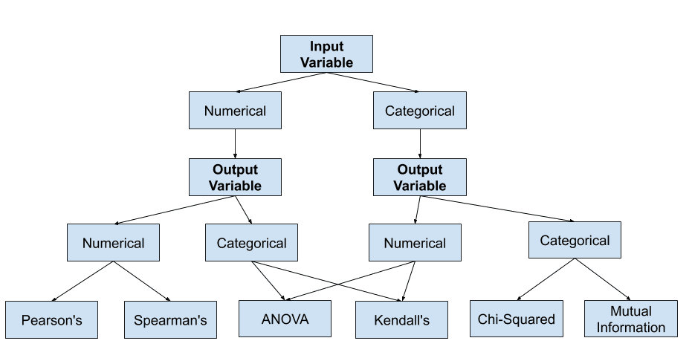

Slide 9
Wrapper Method (After Model Training)
The idea behind wrapper methods is to use a subset of features to train a model and evaluate its performance. This process is repeated multiple times, with different subsets of features, until the best subset of features is found. This iterative process is computationally expensive and requires training multiple models, which is why wrapper methods are typically used after model training.
After the model is trained, wrapper methods can be used to evaluate different subsets of features and select the best one. The selected subset of features can then be used to train a final model, which is evaluated on a test set to estimate its performance on new, unseen data.
Wrapper methods are more computationally expensive than filter methods but can lead to better performance by selecting the most informative subset of features for a specific model. However, wrapper methods are more prone to overfitting and may not work well on datasets with a large number of input features.
In summary, wrapper methods are used during or after model training to select the best subset of features for a specific model. Wrapper methods are computationally expensive but can lead to better performance by selecting the most informative subset of features for the model.
Credits : ChatGPT

Slide 10
Wrapper Method (After Model Training)
Forward Feature Selection
Backward Feature Elimination
Exhaustive Feature Selection
Recursive Feature Elimination
Bi-Directional Feature Selection

Slide 11
Embedded Methods (During Model Training)
Regularization:
  Lasso Regression(L1 Regularization)
  Ridge Regularization (L2 Regularization)
Tree based model Feature Importance:
Decision Tree Feature Importance
Random Forest Feature Importance
AdaBoost Feature Importance
Gradient Boost Feature Importance
Extreme Gradient Boost Feature Importance
CatBoost Feature Importance

Slide 12
Embedded Methods (During Model Training)
The idea behind embedded methods is to integrate feature selection with the model training process. The feature selection is done by using regularization techniques, such as Lasso or Ridge regression, which penalize the coefficients of irrelevant or redundant features.
Embedded methods are used during model training because the feature selection process is integrated with the optimization of the model parameters. This allows the model to select the most informative features for the specific task and reduce the risk of overfitting.
Embedded methods can be used with various machine learning models, such as linear regression, logistic regression, and support vector machines (SVMs). These models are trained with the selected subset of features, and the regularization penalty helps to avoid overfitting and improve the model's performance.
In summary, embedded methods are used during model training to integrate feature selection with the optimization of model parameters. The regularization penalty helps to avoid overfitting and improve the model's performance. Embedded methods are a good choice when there are many input features and the goal is to select the most informative features for a specific task.
Credits : ChatGPT

Slide 13
Feature Extraction Technique
Principal Component Analysis(PCA)
Linear Discriminant Analysis(LDA)

Slide 14
Principle Component Analysis
PCA is different from feature selection techniques like filter, wrapper, or embedded methods. While feature selection techniques select a subset of the original features, PCA creates new features that are linear combinations of the original features.

Slide 15
Blog to Visit
Machine Learning Mastery
CLICK HERE TO VISIT
Or copy Paste the link below
https://machinelearningmastery.com/feature-selection-with-real-and-categorical-data/

